Slide 1
Empowering Families Project
How integrated data and community feedback loops will strengthen family outcomes in Broward County
August 7, 2018

Slide 2
Introductions
Laura Ganci
Director of Research & Evaluation
lganci@cscbroward.org
H. Kay Howard
Manager
hhoward@thirdsectorcap.org

Slide 3
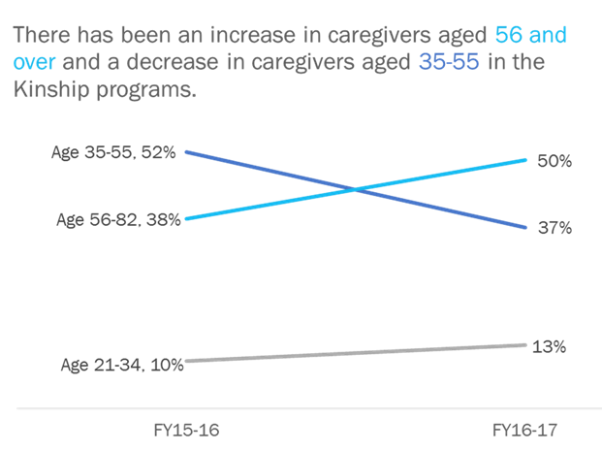
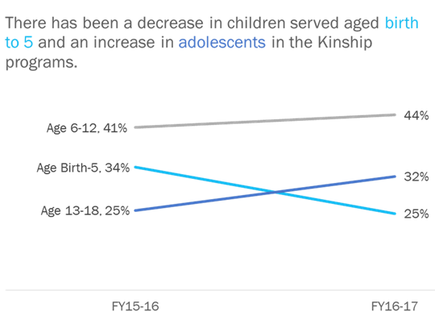
Reflecting on program data, CSC Broward noticed a dramatic change in the population served by their Kinship programs
2017 Analysis of CSC Broward Kinship Programs
Number of caregivers over age 56 increased 12% in one year
Number of adolescents in kinship care increased 10% in one year
Source: Children’s Services Council of Broward County FY16-17 Annual Performance Report: https://cscbroward.org/sites/default/files/2018-06/FY1617AnnualPerformanceReportforweb.pdf
In annual performance reports, CSC Broward noticed that the average age of both the caregiver and the children in Kinship care was increasing.

Slide 4
After discussing the findings with providers and using shared inter-agency data to identify the cause, CSC Broward worked with providers to modify services
Kinship Data Trend Analysis and Action Process
Data Analysis
identified local trends
Provider Meetings confirmed data findings and need for service changes
Services and Trainings were modified to meet local needs on the ground
FSFN Data Analysis
helped identify potential root cause
A data sharing with agreement with the Department of Children and Families (DCF) helped them understand the root cause of this shift in population and adapt services accordingly.

Slide 5
CSC Broward has identified three initiatives to improve on its long history of results-based accountability and using data to drive decision-making
CSC Broward Data & Feedback Loop Initiatives
Build an Integrated Data
System
Link existing administrative data from state, county, and provider sources in order to create a fuller measurement of community needs, services received, and long-term outcomes achieved by children and families
Elevate Participant & Provider Voice
Use community participatory action research with youth voice, surveys, focus groups, and projects to understand local context and lived experience and engage providers and participants as co-creators of upcoming procurements
Create Additional Feedback Loops
Develop systems for engaging providers and participants for ongoing learning throughout service delivery to promote bi-directional learning, continuous improvement, and data-informed decision-making in context

Slide 6
CSC Broward was selected for a national cohort of communities using data and outcomes feedback loops to improve family results
Technical Assistance Providers
Learning Community Members

Slide 7
With AISP’s support, CSC Broward is building an Integrated Data System with many agency partners in order to better inform its system of care
Data Sharing
Secure Data Use
Broward Data Collaborative Partners
BDC Vision
Broward’s Data Collaborative (BDC) integrates state and local data to contribute to the
well-being of Broward’s children, families and communities.
Vision: Broward’s Data Collaborative (BDC) integrates state and local data to contribute to the
well-being of Broward’s children, families and communities.
CSC Broward has been building data-sharing agreements with the listed agencies over the last 10 years.
An IDS provides the governance process, legal framework, technology, and human capacity to safely link
administrative data across multiple agencies to monitor and track how services are being used and to
what effect.

Slide 8
The Children and Youth Cabinet plays a critical role in helping the Broward Data Collaborative vision become a reality
State-Level Role in Promoting Local Data Access & Community Feedback Loops
Continue to Support Data-Sharing
Engage Communities in Data Initiatives
Continue to open doors to state-level data
Promote ongoing support of Agency for State Technology (AST) to uphold standards for data security and client confidentiality
Develop state-wide standard for county-level data-sharing, including interpretation of FERPA and HIPAA
Ensure MSD Statute 1001.212’s creation of an integrated data repository is implemented with guidance and oversight from local funders, service providers, parents, and students
Promote local and state-level “ground-truthing” of data analysis with lived experience of providers and participants

Slide 9
CSC Broward strives to leverage providers’ local expertise and to honor participants’ lived experience in analyzing and interpreting data collected
Pre-RFP Provider & Participant Engagement
Provider Engagement
Participant Engagement
RFP
Provider Survey
Seek provider input on data use and systems challenges
Client Survey
Assess the system of care from a participant perspective and identify what is and is not working
Opportunity to Propose
Learning Outcomes
Encourage providers to suggest “learning outcomes” that they would like to track that will inform continuous improvement
“Data Parties” with Providers
Engage provider curiosity and build capacity around data, increase cross-provider communication, and gather context for data analysis
Community Participatory Action Research
Engage participants in identifying challenges and
co-creating solutions

Slide 10
After piloting provider and participant engagement to inform procurement, CSC Broward plans to build additional, ongoing feedback loops
Use of Data and Provider & Participant Feedback
Fund Disbursement
Community Needs Assessment
Service Procurement
Impact Evaluation
Ongoing Contract Management
Feedback loops leverage data and provider and participant input to measure the impact of day-to-day efforts and support informed, collaborative, and transparent decision-making in order to better align resources, services, and efforts to improve outcomes.

Slide 11
With access to additional quantitative and qualitative data, CSC Broward envisions a future of scaling sophisticated analysis and responsive action
Vision for Impact of CSC Broward’s Data and Feedback Loop Initiatives
All CSC Broward
Programs
($78 M)
Increased
Impact
Family Strengthening Programs
($12 M)
Kinship Program
($1 M)
Scaling data access and community feedback loops across programs
Source: Children’s Services Council of Broward County FY16-17 Program Services Budget: https://cscbroward.org/resource/fy-2016-17-program-services-budget

Slide 12
Disclosure
This presentation contains confidential, proprietary, copyright and/or trade secret information of Third Sector Capital Partners that may not be reproduced, disclosed to anyone, or used for the benefit of anyone other than Third Sector Capital Partners unless expressly authorized in writing by an executive officer of Third Sector Capital Partners.
Third Sector Capital Partners, Inc. Boston • San Francisco • Washington, D.C. info@thirdsectorcap.org | www.thirdsectorcap.org

